Slide 1
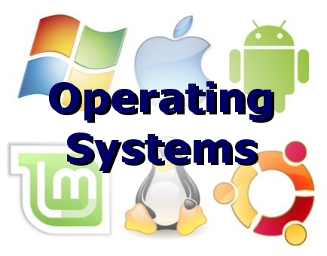
Operating Systems

Slide 2
Software
Software – the instructions that make the CPU do useful things
Divided into two main categories
  System software
  Applications

Slide 3
Two categories of Software
Applications help you get your work done
  Word processing, spreadsheets, music players, browsers, graphics editors
System software keeps the computer functioning correctly
  Utilities – defragment, virus checkers
  Operating System – controls the hardware parts of the computer as well as the other software

Slide 4
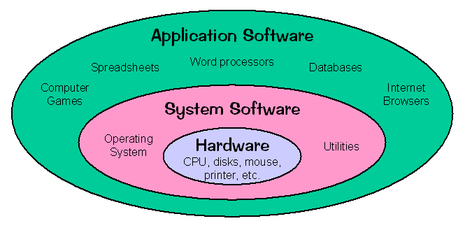
Diagram of a computer system

Slide 5
Apps and OS work together
An application like MS Word is given a command “Print this document”
It passes the file and the command to the OS (Word does not know much about printers)
The OS does know about printers and how to communicate with them
The OS sends the document to be printed then reports to MS Word that it has been printed
The printer prints

Slide 6
The OS’s jobs
Manage memory (remember virtual memory – that’s the OS)
Manage the file system (so that it knows where files are, can delete them, copy them)
Manage the User Interface (GUI, CLI)
Manages the hardware resources – mouse, keyboard, printer, speakers
Manages the CPU(s) to perform the user tasks requested (multi-tasking, multi-threading)

Slide 7
Managing CPUs
Multi-tasking
  Most OS’s do this these days
  On Windows press Alt-Tab or look at Task Manager to see what’s happening “at the same time”
  If only one CPU, multi-tasking is a simulation, slicing up CPU time and giving one slice to each task that wants to run

Slide 8
Multiprocessing
If the machine in question has more than one physical CPU, then multitasking is done by literally giving each processor a task
The OS needs to know this is happening so that it can
  Divide tasks into pieces for different CPUs
  Balance the load between CPUs
  Help the CPUs communicate with each other
  Manage each processor’s RAM

Slide 9
Multithreading
A more specialized form of multitasking
Suppose ONE application had several things it needed to do, which could be done independent of each other
Arranging those to happen “at the same time” for the SAME application is multithreading
A game might be rendering a graphics scene at the same time it’s figuring out the aliens’ next move
Can be done with one CPU (simulation) or more CPUs (multiprocessing)

Slide 10
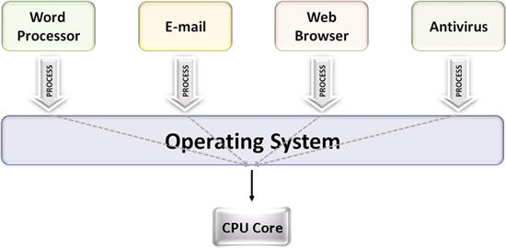
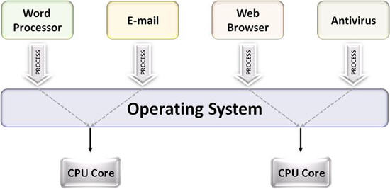
Single core vs. Multi core

Slide 11
User Interface
OS has to make it easy for the user to communicate their requests to the computer
First interface was CLI = command line interface
Still visible in Windows as “command window” or in MacOS as “Terminal” window
Not very friendly – depended on user to remember commands and filenames

Slide 12
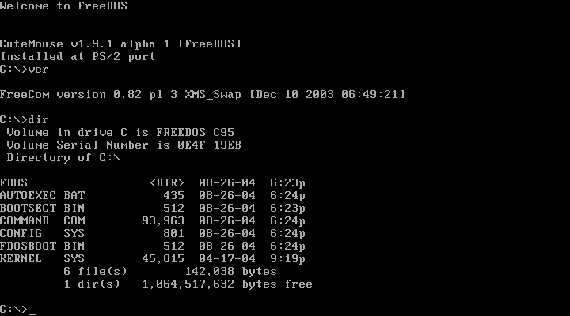
CLI

Slide 13
User Interfaces
Basic control elements of a GUI (graphical user interface)
  Desktop
  Taskbar or dock
  Dropdown menus
  Start screen
  Icon
  Pointing device
Xerox PARC (Palo Alto Research Center) – first GUI
Steve Jobs ‘borrowed’ it from them for the Macintosh
Bill Gates ‘borrowed’ it from Apple for Windows

Slide 14
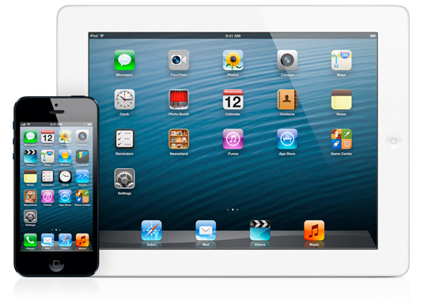
Sample GUI

Slide 15
Does the OS matter?
Having an OS? yes! Without it your computer will not be useable
Having one OS versus another? Yes! Most software insists on being installed on one operating system and one only
Which one is best? That is very much a matter of opinion

Slide 16
The Big Names in OSes
Microsoft Windows in all its versions has about 90% of the Desktop OS market
Mac OS X has about 4%
Linux has about 2%
https://en.wikipedia.org/wiki/Usage_share_of_operating_systems#/media/File:Operatingsystem_market_share.svg

Slide 17
UNIX and Linux
The UNIX operating system was developed in 1969 at AT&T’s Bell Labs, by Dennis Ritchie and Ken Thompson
  Dependable in multiuser environments
Linus Torvalds created Linux based on what he knew of UNIX
Linux is an operating system distributed along with its source code under the terms of a GPL (General Public License)
  A Linux distribution is a download that contains the Linux kernel, system utilities, graphical user interface, applications, and an installation routine. It is free.
Unix and Linux are more stable than other operating systems. = do not crash as often

Slide 18
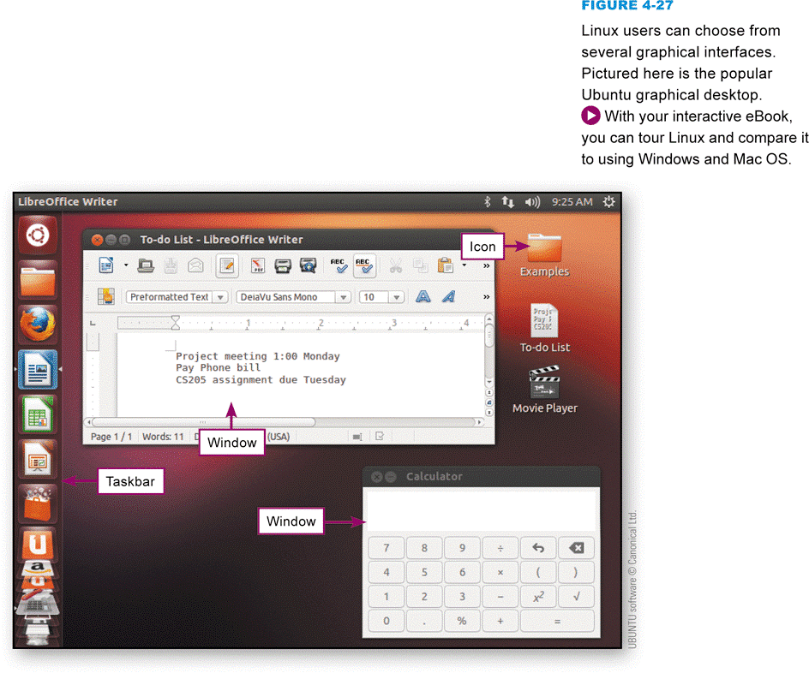
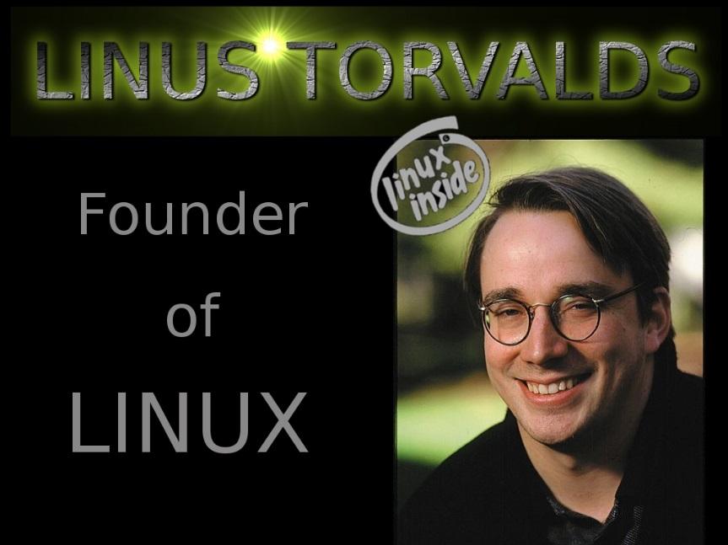
UNIX and Linux
Notes:
Figure 4-27

Slide 19
Other OSes
Android for non-Apple phones and tablets
  created by Google
iOS for Apple iPhones and iPads
Microsoft also has one for its Windows devices
Android has biggest share in market for mobile devices

Slide 20
What do you want from an OS?
Compatibility with
  Hardware
  Software
Ease of use
  Intuitive interface
Reliable
  Stable
Price

Slide 21
Being a good OS user
Cleaning up your drives
  In Windows, right clicking on a drive icon and then “Properties” will show you how full the drive is
  An app like CCleaner can help you get rid of temporary files from your browser
  Putting a file in the Recycle bin does not really erase it
To speed up an application
  Don’t have too many others running, even in the background

Slide 22
Be a good OS user
Be aware of how many applications you have running at one time
  Too many can slow all of them down
  All of them take up memory and CPU cycles, even when minimized
Usually have to find the “Quit” or “Exit” choice on a menu to actually stop app
Some apps have “memory leaks” where they continually take up more and more memory
  An error in the app
  Stopping it and restarting it may help
Every OS has some way to see what processes and applications are running – Windows, it’s Task Manager

Slide 23
Being a good OS user
Make backups
  Copy of important files
  In case hardware fails, computer is stolen, file is accidently deleted
  Put the backup copies somewhere else, not on the same computer
  Vitally important for businesses!

Slide 24
Backups continued
Companies can go out of business if they lose their data = customers, invoices, inventory, accounts payable, accounts receivable
They make regular backups and (ideally) put them somewhere physically separate from the business location
Manual backups, automated backup systems
Recovering a file from a Recycle bin – does not always work!!

Slide 25
Why do you need backups?
You accidently erased a file you need
The computer was stolen or lost or destroyed
The hardware (hard drive, SSD, etc.) failed and the data is inaccessible or corrupted
There are companies which specialize in recovering data from devices – they are not always successful and they are always costly!

Slide 26
Cautions about deletions
Case I: you think something is deleted completely and it is NOT!
  Word keeps text that is “deleted” in the file! Some politicians have found this out the hard way
Case II: you think something is not “really” deleted and it IS!
  The Trash Can/Recycle Bin on your Desktop will not restore a file indefinitely! The longer you wait between deletion and restoration, the less likely it will work!

Slide 27
Device Drivers
If you want to add a new piece of hardware to your computer system, like a printer, modem, scanner, etc. the OS may not know how to talk to it.
The device should come with software (on a CD or downloaded from the manufacturer’s site) that is installed so that it is part of the OS. This software is a device driver.
Modern OS’s usually have device drivers for most standard hardware, so you don’t have to do anything.
But if a new device does not seem to work some or all of the time, check to see if you need to install (or update) a device driver. Check the manufacturer’s site.
This software prevents application developers from having to write code to deal directly with hardware devices. The driver in the OS acts as a “middleman”.

